Slide 1
Distributed Machine Learning – Assignment 2 Comparative Study and Implementation of Communication-Efficient and Semi-Supervised Vertical Federated Learning

Slide 2
Team Members:
Subhransu Mishra – 2023AC05489
Dulal Das – 2023AC05041
Lakshmisrinivas Perakam – 2023AC05540
Archan Ghosh – 2023AC05402

Slide 3
Objective & Motivation
Vertical Federated Learning (VFL) allows collaboration across organizations with disjoint feature spaces.
Challenges:
Limited overlapping samples
High communication overhead
Goal: Compare two modern VFL approaches:
FedCVT (semi-supervised, cross-view)
Communication-efficient VFL (Sun et al.)

Slide 4
FedCVT – Overview
Key Idea: Use pseudo-labeling and cross-view training to exploit unlabeled and unaligned data.
Components:
View-specific encoders
Missing-view representation estimator
Pseudo-label generator
Joint training of classifiers
Benefits: Improves accuracy with limited overlap
Communication-Efficient VFL – Overview

Slide 5
Communication – Efficient VFL - Overview
Key Idea: Minimize communication using one-shot or few-shot protocols.
Components:
Local SSL on clients
Minimal server coordination
Benefits: Drastically reduces bandwidth usage

Slide 6
Comparison Table
Aspect | FedCVT | Comm.-Efficient VFL (Sun et al.)
unication | Multi-round | One/few-shot
Label Requirement | Pseudo-labels | SSL on unlabeled data
Overlap Assumption | Limited | Minimal
Architecture Components | Encoders, estimators, classifiers | SSL extractors, fusion head
Use of Unlabeled Data | Extensive | Moderate

Slide 7
Simulation Setup
Dataset: UCI Adult / Credit
Clients: A-view and B-view
Overlap: ~10–20% shared samples
Privacy: Gaussian noise masking
Modes Implemented:
One-shot VFL
FedCVT-style VFL

Slide 8
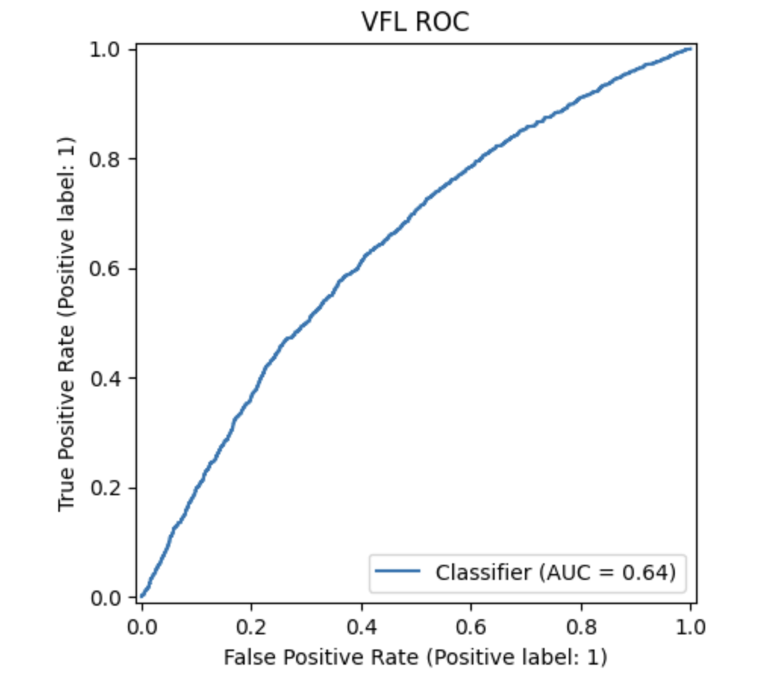
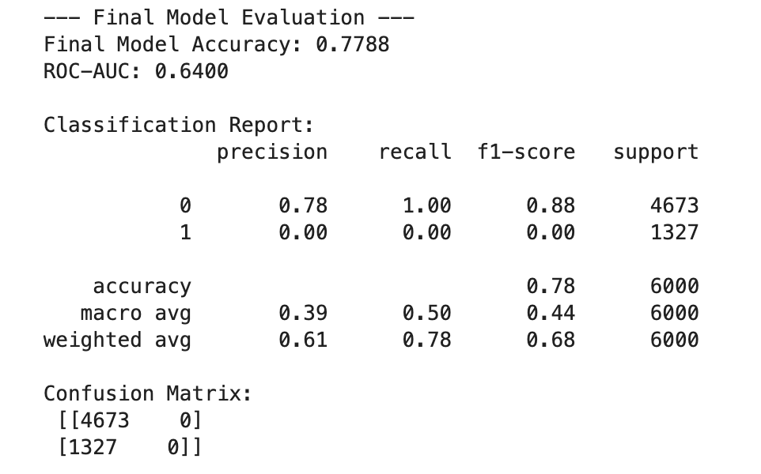
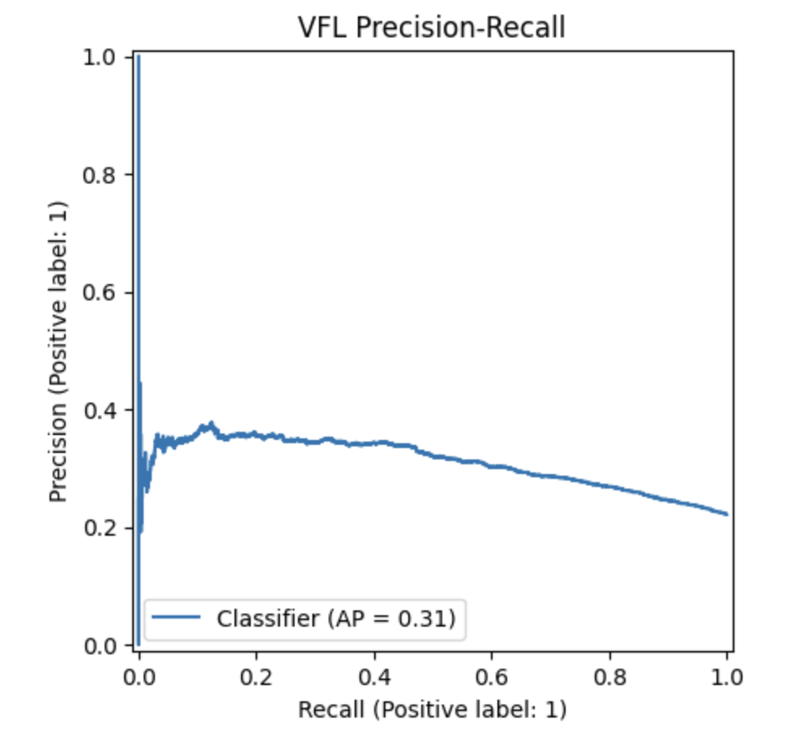
Results Summary:

Slide 9
Insights & Implications
FedCVT:
Best accuracy
Requires more communication
Comm-Efficient VFL:
Ideal for low-resource settings
Slightly lower performance
Real-world relevance:
Healthcare, finance, advertising
Limited overlap is common

Slide 10
Conclusion
FedCVT excels in data-rich environments
Comm-efficient VFL suits bandwidth-constrained scenarios

